Slide 1

Crowthorne Church of England Primary School
Beginning of the new academic year 2026
parent information session.
Notes:
I would like to welcome you all to the Year 4 Parent Information Session 2026.
It has been great getting to know your children better over the last week and they are settling into Year 4 really well.
In this time, we will talk through some Year 4 general information and expectations, as well as some key information you will need.

Slide 2

Driven by high expectations; promoting excellence
Meet the team!
Class Teacher- Miss Price
Teaching Assistant- Mrs Abdi
Notes:
To properly introduce myself, my name is Miss Price, and I will be your child’s class teacher.
So a little bit about me- Having always had a passion for teaching and working with children, I followed this and graduated from the University of Winchester with a First Class Honours in a Primary Education degree with a qualified teacher status. This is now my third year at Crowthorne CofE.
Mrs Abdi will be the class teaching assistant. She works Monday to Thursday.

Slide 3
Driven by high expectations; promoting excellence
General Information
Communication with the school
Attendance- Atty
PE days – Tuesday and Thursday (no jewellery- earrings should be taken out or taped up and proper trainers are needed for outdoor P.E rather than plimsolls)
Before/After school expectations (8:40 soft start).
Uniform
Notes:
Firstly, we will go through some general information.
Communication with the school- Please do email early in the day if there is a change of adult for pick-up.
Communication with the teacher- You can request a meeting with me face to face or an email via the office. Please try to catch me after school at pickup rather than drop off. Please email the office if it is urgent.
Attendance- Children can come in through the side door and we will open the door at 8:40- we do ask that the children wait sensibly and quietly.
Some children may start cycling or scooting to school but just a reminder there should be no cycling or scooting in the playground.
If you are running late and your child arrives at school after 8:45, your child will need to come in via the office.
Please phone before 9:00am to inform us of any absences.
PE days- Year 4 PE days are Tuesday and Thursday. No jewellery should be worn- earrings should either be taken out or taped up. Children will store their PE kit in their locker located in the classroom, which can be jogging bottoms and a sweatshirt for colder weather. The children will need proper trainers for outdoor PE rather than plimsolls.
Uniform- At Crowthorne, we believe that uniform looks tidy, is practical, contributes to a feeling of belonging and helps to encourage a special pride in the children. A full description and listing of the uniform can be found on the school website under home, parents then uniform.

Slide 4

Driven by high expectations; promoting excellence
Behaviour and classroom expectations
Class charter
Rewarded for high standard of work/behaviour
Pencil case- pencils, rubber, ruler, sharpener, coloured pencils, notebook
Lockers and Trays
Notes:
As a class, we have made a class charter that has been signed by everyone as a promise to follow the school and classroom rules.
Children will be rewarded for high work standards, effort and behaviour through aspects such as house points, good citizen awards, star of the week and class smileys. We also use an adapted traffic light system for behaviour throughout the school. Each child starts the day on green. With exceptional role model behaviour and for going above and beyond, children can move to silver and finally to gold, where they will get a Crowthorne CofE gold award sticker. However, if a child on green is given a warning and they continue to make the wrong choices, the child's name will be removed from green. If your child completes an outstanding piece of work, displays characteristics of an effective learner or puts in extra special effort, they will receive a headteacher's visit. We don’t want children to sit back, but expect a good and positive attitude to learning.
Children should come to school prepared with a pencil case containing pencils, a rubber, ruler and sharpener.
Each child in the class has a tray and a locker to store personal belongings.

Slide 5
Driven by high expectations; promoting excellence
Curriculum & Learning
Curriculum Overview
Termly Curriculum Overview
Assessment – Termly assessment on Reading, Maths, SPAG, Times tables
Times Table Multiplication Check
Notes:
The Year 4 curriculum overview will be shown on the next slide of this presentation and can also be found on the school website.
Teacher assessment is ongoing throughout the year.
We do carry out formal tests for Maths, Times tables, Reading and SPAG at the end of every term to check progress, inform target setting and our teacher assessment. This is a good preparation for Year 6 and from previous years, the children are used to this. At the end of the year, we will report whether your child is working towards the expected level, at the expected level or working above the expected level for their year group. We will discuss your child's progress at parents evening.
We are now sending home a maths homework sheet. This will be sent home on a Friday and isn’t expected back until the following Friday.
Times tables are especially important in Year 4. The multiplication tables check or MTC is statutory for all year 4 pupils and has the purpose of determining whether pupils can recall their times tables fluently, which is essential for future success in mathematics. This also helps schools to identify pupils who have not yet mastered their times tables so that additional support can be provided. This takes place in the summer term. As well as practising Times tables in school, your child should also be practising them at home regularly. This can be done on Hit the button, Maths Frame, writing them out and reciting them orally.

Slide 6
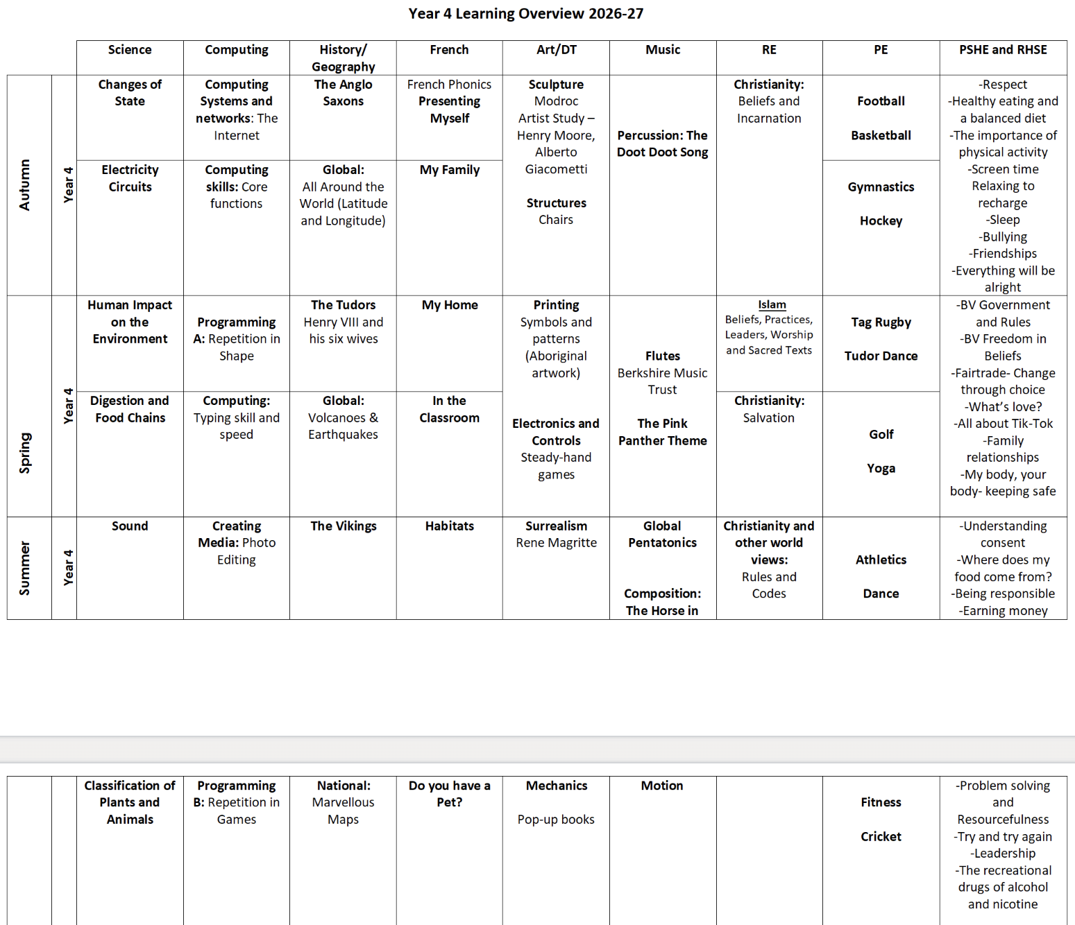
Notes:
On this slide is the Year 4 curriculum overview at Crowthorne CofE. There is also a more detailed Autumn term overview on the Year 4 class page.

Slide 7
Driven by high expectations; promoting excellence
The importance of supporting your child
Reading
Children hand in reading records every Monday (even if they have not finished their book).
We recommend children read daily 20 minutes.
We ask for parent signatures/comments once a week.
Support you can give your child at home with reading.
Notes:
Children hand in reading records every Monday.
We recommend that the children read daily for 20 minutes. We ask for a parent signatures/comments once a week. The book(s) they are reading should be transported between home and school along with their reading record book- we check the books every Monday to monitor the children’s reading.
Help at home by asking your child to clarify the meaning of unfamiliar words- in lessons we have been working on this, looking at the words around the word we don’t understand this enables children to be more independent and allows the child to have a go before asking an adult, ask questions they want to know the answers to, summarise what they have read in their own words and predict what will happen based on events so far. Reading assessment is a ‘comprehension’ style assessment.

Slide 8
Driven by high expectations; promoting excellence
Spellings – Spelling shed.
Ten new spellings each week.
Homework sheet is sent home on a Wednesday to be returned for/by Monday.
Notes:
We use spelling shed for spelling. We have ten new words each week that we look at almost daily in school, discussing the meaning of the words and looking at the spelling pattern if applicable. Children are therefore tested more informally in school to check their understanding. The children will be given a spelling homework sheet weekly which we encourage all children to complete and bring back into school. We mark the spellings as a class, but I see all the homework before it is filed in the children's folders.

Slide 9
Driven by high expectations; promoting excellence
Events throughout the Year (TBC)
Class Assembly
Class Trip- (Focus TBC- Spring/Summer term)
Tray Days
Parents Evening – Autumn face to face (6th and 8th October 2026) and Spring online
Church services
Sporting events
PTA events- check Newsletter
Harvest Festival

Slide 10
Driven by high expectations; promoting excellence
Thank you for your support.
Notes:
Thank you for your support, it is really appreciated.
Communication is key, so please feel free to reach out with any questions or concerns.
I look forward to working with you and your child over the next academic year. Thank you.

