Slide 1


Crowthorne Church of England Primary School
Beginning of new academic year 2026
Parent Information Session.

Slide 2

Driven by high expectations; promoting excellence
General Information
Class Teacher: Mrs Cook
T.A: Mrs Westmore (Mon-Wed)
Mrs Parker/Mrs Ramery (Friday/Cover)
Notes:
Importance of attendance/punctuality- children can come into the side door and we will open the door at 8:40- we do ask that the children wait sensibly and quietly.
Some children may start cycling or scooting to school but just a reminder there should be no cycling or scooting in the playground.
If you are running late and your child arrives at school after 8:55, your child will need to come in via the office.
Please phone before 9:00am to inform us of any absences.
Our P.E days are Mondays and Wednesdays- As the weather becomes cold- jumpers and jogging bottoms are advised as well as trainers and a plastic bag.
Some children have their ears pierced- just a reminder to take them out or tape them up. No jewellery policy.
Communication with the school- email or phone Mrs Fallows.

Slide 3
Driven by high expectations; promoting excellence
General Information
PE days – Tuesday and Friday
Before/After school expectations (8:40 soft start).
Communication with the school- Through school office or a quick playground catch up after school.
Uniform including P.E kit- jackets and jogging bottoms for outdoor P.E in colder months. No jewellery to be worn and hair needs to be tied up please.
Notes:
Importance of attendance/punctuality- children can come into the side door and we will open the door at 8:40- we do ask that the children wait sensibly and quietly.
Some children may start cycling or scooting to school but just a reminder there should be no cycling or scooting in the playground.
If you are running late and your child arrives at school after 8:55, your child will need to come in via the office.
Please phone before 9:00am to inform us of any absences.
Our P.E days are Mondays and Wednesdays- As the weather becomes cold- jumpers and jogging bottoms are advised as well as trainers and a plastic bag.
Some children have their ears pierced- just a reminder to take them out or tape them up. No jewellery policy.
Communication with the school- email or phone Mrs Fallows.

Slide 4
Driven by high expectations; promoting excellence
General Information
Rewards- House points, Good Citizen, good work, Celebration assembly, traffic lights in the classroom (updated).
Assessments every term for the teacher to know where the children are and what they need further support with.

Slide 5

Driven by high expectations; promoting excellence
Pencil Cases
Pencil, handwriting pen, purple pen, rubber, ruler, sharpener, coloured pencils, highlighter, notebook.
Lockers and Trays are used to store their equipment.

Slide 6
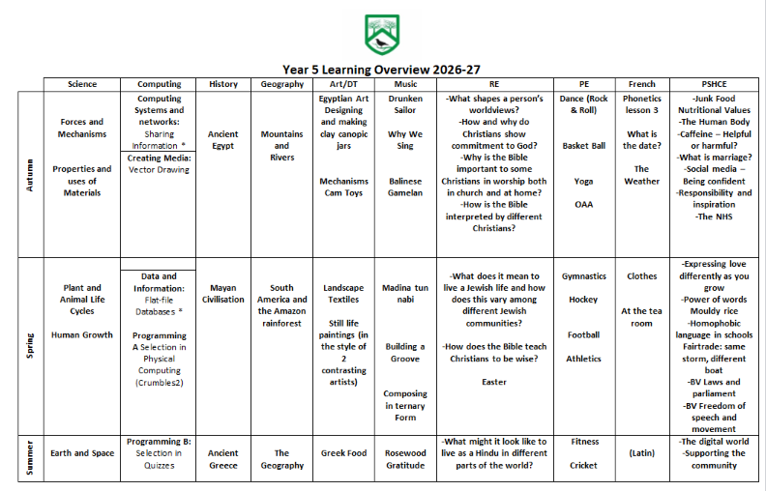
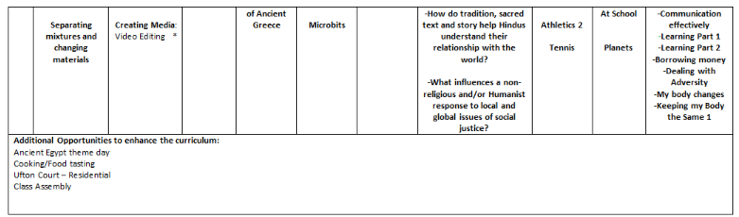
Driven by high expectations; promoting excellence

Slide 7
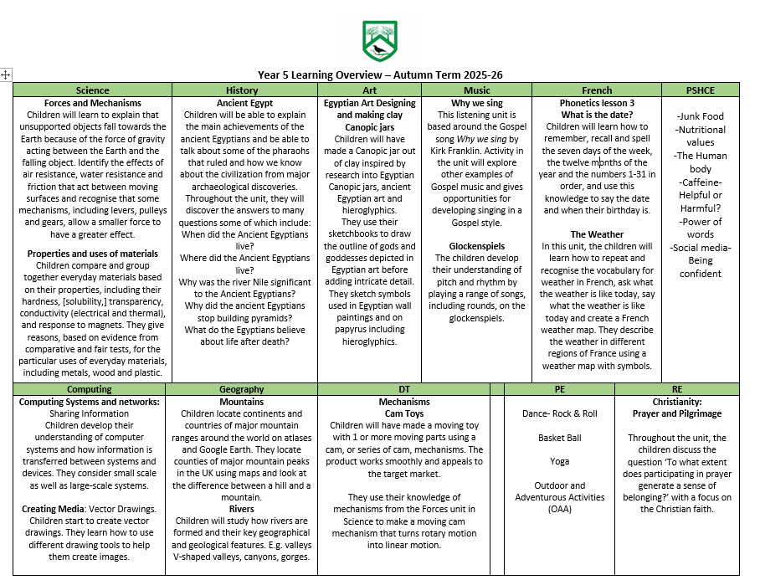
Driven by high expectations; promoting excellence

Slide 8
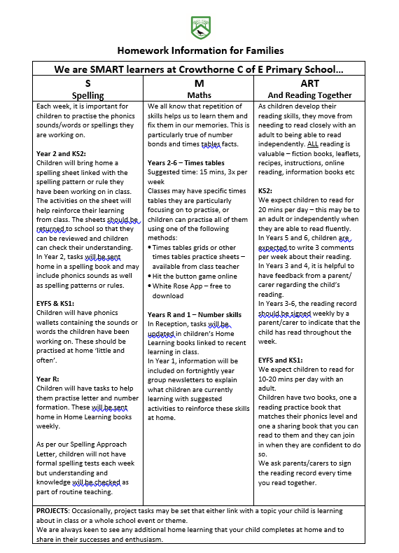
Driven by high expectations; promoting excellence
HOMEWORK
Home learning - SMART
Spellings- the same system as last year
Maths – A weekly Maths task will be given
All homework will be given on a Thursday and be due in on the following Wednesday.
Reading

Slide 9
Driven by high expectations; promoting excellence
The importance of supporting your child
Reading
Children hand reading records in every Monday. In Y5 Children to comment 3x weekly and signed by parents once each week.
Follow a Reading scheme.
Benchmarking.
Strategies (Clarify, Question, Predict, Summarise)

Slide 10




Driven by high expectations; promoting excellence
Curriculum & Learning
Focus Novels this year: Please do not read ahead!

Slide 11
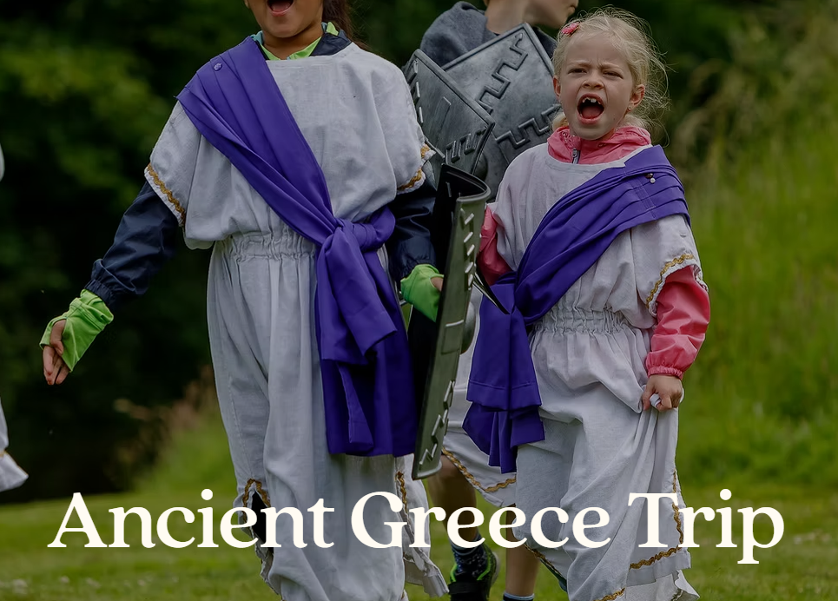
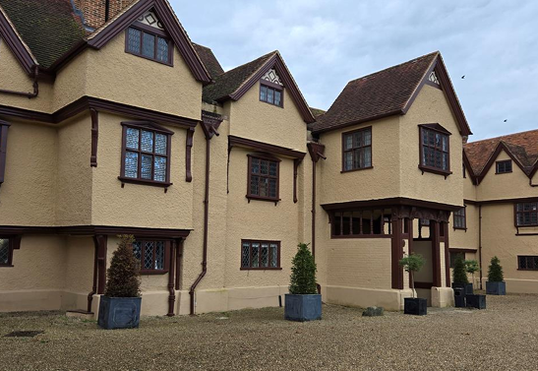
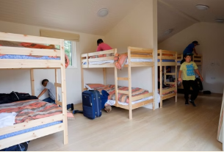
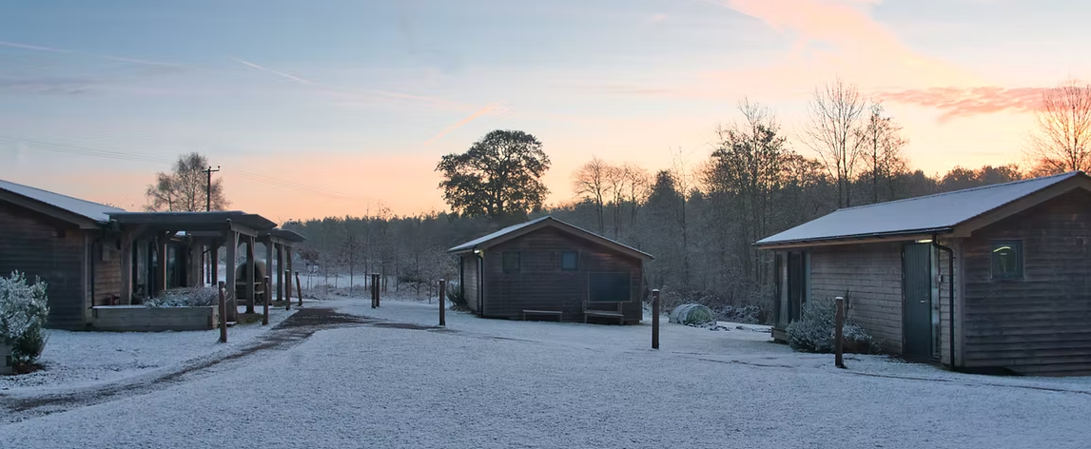
Driven by high expectations; promoting excellence
Ufton Court Residential 17th-19th May 2027

Slide 12
Driven by high expectations; promoting excellence
Events throughout the Year
Parents Evening w/c 5th October
Egyptian day!
Class Assembly
Class Trip- Ufton Court residential in May
ECO days
Tray Days
Church services
Sporting events
PTA event- check Newsletter
Notes:
We will have a separate meeting about Beaulieu nearer the time but it is a great opportunity- for some children it will be the first time they have been away from home and what better wat to do it than with their friends and adults they know so well. I have been on the trip before and it links well to the curriculum in terms of what is covered in Geography with the river survey,, looking at land use, map reading and using a compass as well as orienteering for P.E but it is also great for team building, having new experiences and learning outside the classroom.

Slide 13

Driven by high expectations; promoting excellence
Thank you for your support.

