Slide 1

Crowthorne Church of England Primary School
Beginning of new academic year (2026-27)
parent information session.
Notes:
Thank you for coming tonight.
I’’ll start by going through some of the general information about life in year 6 and then we will move on to assessment this year and the meeting about school journey

Slide 2
Driven by high expectations; promoting excellence
General Information
Attendance
PE days – Thursday (coach) and Friday
Before/After school expectations
Communication with the school
Uniform
Notes:
Importance of attendance / punctuality – children have a soft start. Please phone before 9.00 to inform us of any absences.
We will have a further meeting later in the year with more information about residential and SATs.
What do they need for PE?
As soon as they enter school gate dismount any bikes, scooters etc - no cycling or scooting in playground (by any child – even younger siblings)
Communication with teacher – fine to chat before school – but please be aware we are in class with the children– so not private!! If you are giving teacher important information about pick up etc – might be worth writing it down – just in case teacher forgets..
If you request a meeting with the teaching staff, arrange this through the office or face to face, please let us know what you wish to discuss so that we can make sure we are fully prepared and have the information you need.

Slide 3






Driven by high expectations; promoting excellence
Curriculum & Learning
Curriculum Overview
Expectations of Learners
Reading at home – reading prompts/recommended list on website
Homework: SMART – Spelling, maths & reading
Assessment
Notes:
Go through topics where appropriate
Expectations – rewarded for high standard of work/behaviour. Poor attitude to work or behaviour could lead to loss of privileges already spoken about taking responsibility for own actions.
Reading is very important. Gateway to everything.
Year group expectations can be given out at Assessment Info evening

Slide 4
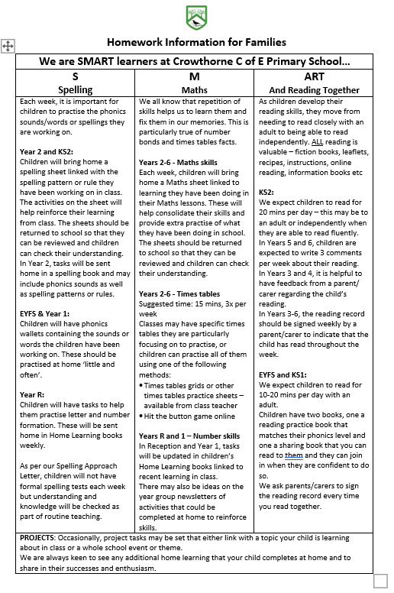

Slide 5
Driven by high expectations; promoting excellence
The importance of supporting your child
Home learning
Spellings – weekly activities (no formal testing)
Spelling homework sheet
Maths – Times tables/Active Learn games/worksheet
Reading (reading, reading….) – adult signature
Encouraging writing
Supporting school staff
Notes:
Go through your expectations. No passive learners – don’t want children to sit back.
I won’t allow the children to blame you if their homework is late or they don’t have their PE kit…it is their responsibility. Similarly, please encourage them at home to take responsibility for their actions and for preparing themselves for a day at school.
Homework is important as it reinforces what is taught and learnt in school – expected to be of the same quality as in class – handwriting etc
Please look at any question in reading records– and support your child with this – signing record regularly, checked each Monday. Variety of authors see book list to help and link on web page
Remind parents of our writing focus – and the need for children to see writing as an important skill – we are trying to ensure children see adults writing regularly and for enjoyment – please support at home.

Slide 6
Driven by high expectations; promoting excellence
Mobile phone
Phone policy
Social media
Notes:
Mobile phone policy and reasoning behind it. Parents to check phones and be aware of messages. Issues out of school have had to be dealt with in school. Appropriateness of sites/apps etc. Talk to children about going to a safe place if feeling worried on the way home and then phoning an adult.
Not a right of passage in Year 6. Mrs Hicks will review each application individually. It is not an automatic yes!

Slide 7
Driven by high expectations; promoting excellence
Medicines
Prescribed by the doctor with name of child, dosage and frequency.
Emergency materials kept in class, all other kept in the office.
Trip medication

Slide 8
Driven by high expectations; promoting excellence
Events throughout the Year
Tag Rugby tournament: 15th October
Victorian Day: 22nd October
Links with Wellington Prep
Bikeability WB: 28th September
Class Trip – PGL: 15th – 19th March
Church
PTA events
Sporting events: rugby, athletics, cricket, cross country
Enterprise – before Christmas – 3 sale days
Notes:
Talk through
We always try to give as much notice as possible. Please read all school communications carefully

Slide 9
Driven by high expectations; promoting excellence
Prefect duties
House Captains
Assembly monitors
IT monitors
Buddies
School Ambassadors
Worship Leaders
Librarians
School Council Representatives - Charity fundraising ideas
Eco Team
Notes:
As Year 6 children they are expected to take on many different responsibilities. They are relied upon to be excellent role models to the younger children. Once given a duty, the children are expected to fulfil the role to the highest standard. Were possible the rotas will still allow the children to have plenty of time outside.

Slide 10
ASSESSMENT

Slide 11
Assessment - week commencing 10th May 2027
Driven by high expectations; promoting excellence
In the summer term of 2027, children in Year 6 will be sitting their SATs papers. They test the children’s learning throughout KS2 in English and Maths.
At the end of Year 6, children will sit tests in:
Reading
Maths
Spelling, punctuation and grammar
These tests will be both set and marked externally; reported to your chosen secondary school and the results will be used to measure the school’s performance. Your child will be teacher assessed in writing – there is no formalised test but all schools are moderated.

Slide 12
Driven by high expectations; promoting excellence
Scaled Scores:
Scaled scores are used all over the world and help test results to be reported consistently from one year to the next.
100 will represent the ‘national expected standard’.
Scale will have lower end point below 100 and upper end point above 100.
Last year scores over 110 were considered to be working at greater depth in the curriculum.

Slide 13
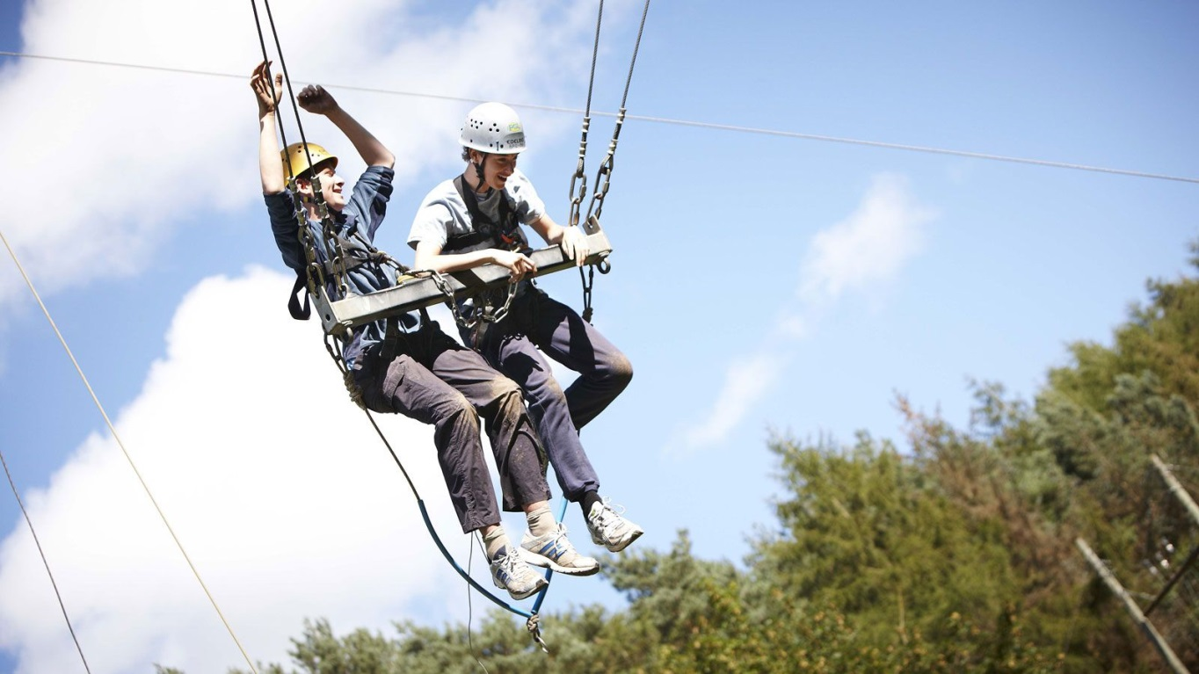
Driven by high expectations; promoting excellence
PGL – Marchant’s Hill: 15th –19th March 2027

Slide 14
Driven by high expectations; promoting excellence
Programme – PGL Marchants Hill – 15th – 19th March 2027
Leave school Monday 15th March at approx 11am - arrive at school for 10.30am
Travel by coach to PGL, Marchants Hill, Hindhead,
Afternoon activity, dinner, evening entertainment as determined by the centre.
Choice for daily activities attached – but to be confirmed by the centre.
We will have organised activities throughout the week including a hike.
Return to Crowthorne on Friday 19th March, after completing a morning activity.

Slide 15
Driven by high expectations; promoting excellence
Supervision
3/4 adults
Accommodation block on site Pupils - En suite rooms sleep 4/6 Teachers - Single or twin en suite rooms.
The children will be spilt into 3 equal groups, each assigned to an adult.
During each activity there will be an appropriately qualified member of Centre staff with each group.
Staff bedrooms will be spread among the children’s rooms.

Slide 16

Driven by high expectations; promoting excellence
Thank you for coming.
Any Questions?

