Slide 1

Crowthorne Church of England Primary School
Beginning of new academic year parent information session.

Slide 2

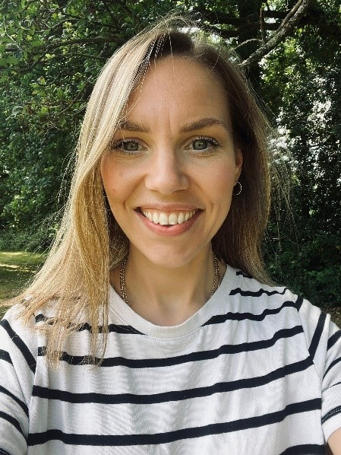
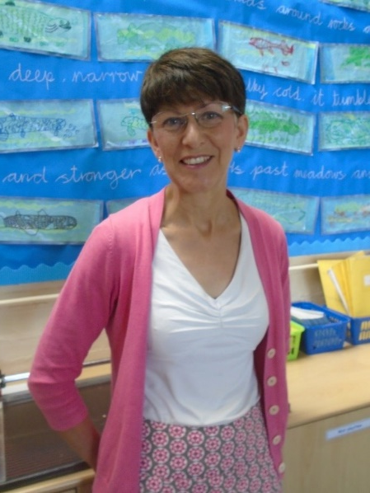
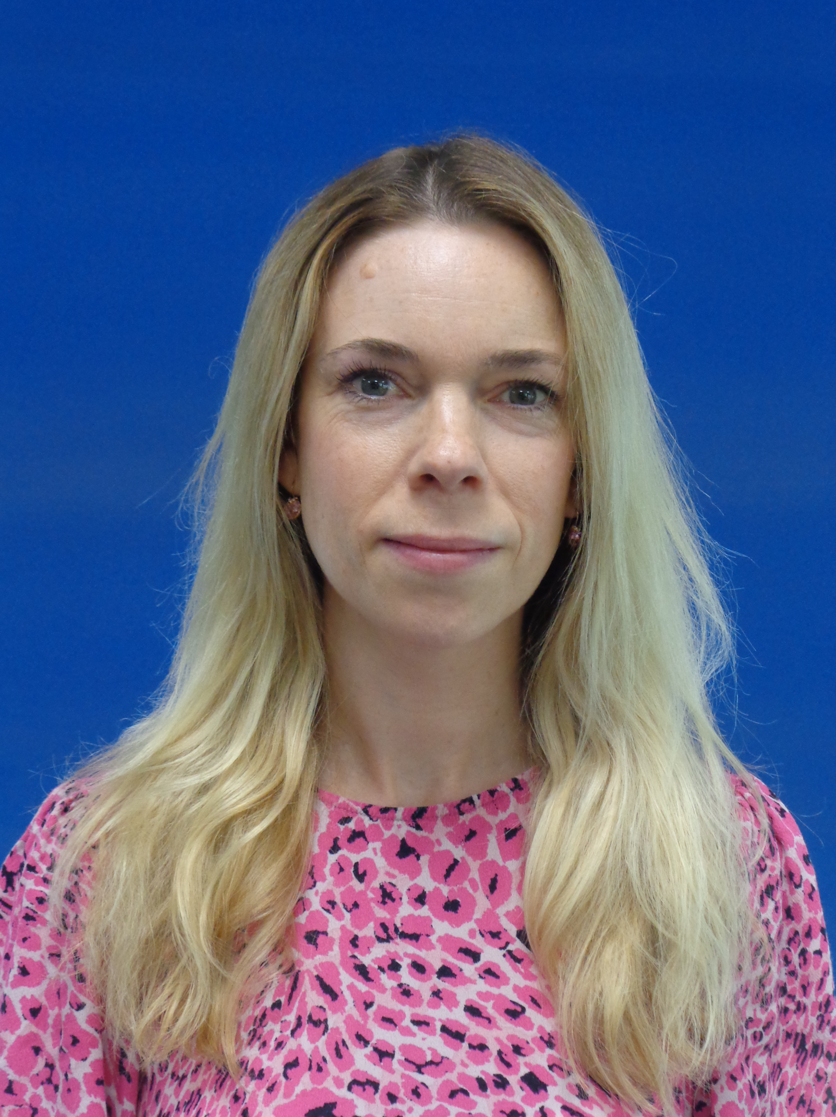
Inspiring and enabling our school community to live life to the full
Welcome
Congratulations – a great start!
Introductions

Slide 3
Inspiring and enabling our school community to live life to the full
Daily routines
Ordering lunches – please order at home
Bring a reusable water bottle every day
Bring a coat every day in cooler weather
Snack time – fruit or veg
Bring a book bag everyday
Tell your child if they are going to ASC
Let us know if someone different will be collecting your child

Slide 4
Inspiring and enabling our school community to live life to the full
Weekly routines
Mondays – Reception Newsletters will be sent home
Mondays – New Reading Practise books will be sent home
Mondays – PE – Children will wear their PE kit home
Wednesdays – Library books will be changed
Thursdays – New sounds and words to practise will be sent home.
Thursdays - Home Learning Books will be collected in
Fridays – New Home Learning will be sent home

Slide 5
Inspiring and enabling our school community to live life to the full
General Information
Attendance
Before/after school expectations
Communication with the school
Uniform – name everything! YES, EVERYTHING!
Birthdays – wear own clothes
Accidents – please wash and return any clothes borrowed from school
Medicines – must be handed in at the office and paperwork completed

Slide 6
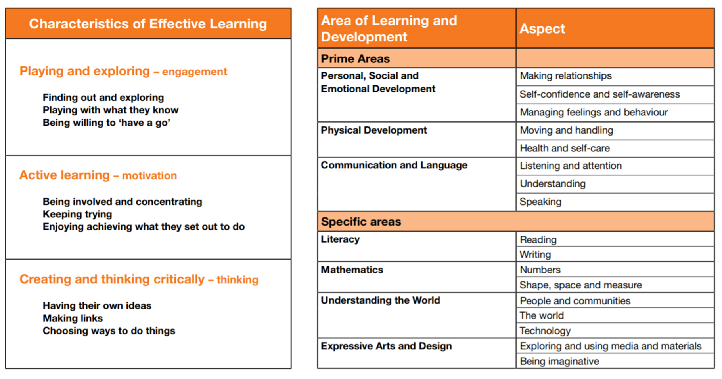
Inspiring and enabling our school community to live life to the full
Curriculum & Learning

Slide 7
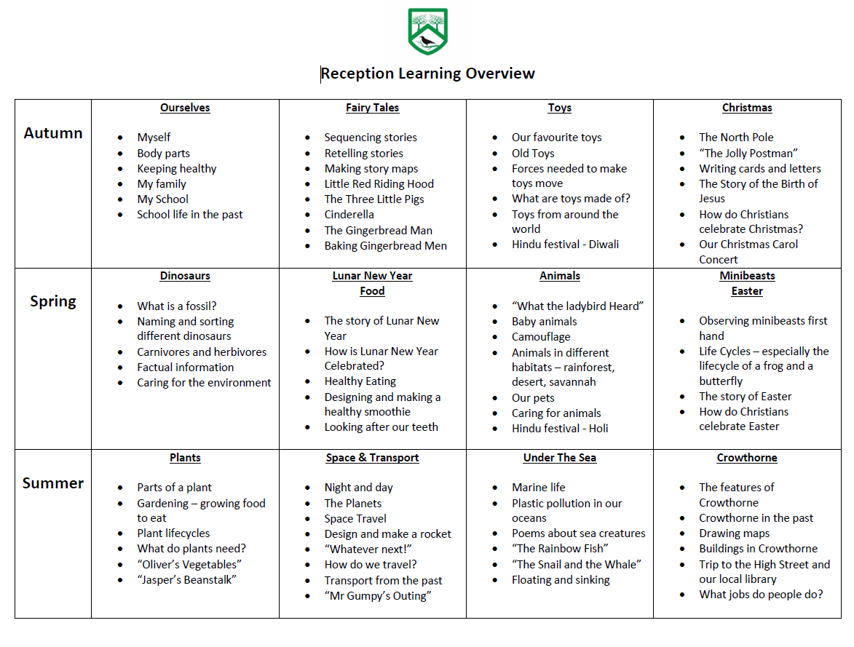
Inspiring and enabling our school community to live life to the full
Curriculum & Learning

Slide 8
Inspiring and enabling our school community to live life to the full
Curriculum & Learning
Planning takes account of different needs
Learning through play
Expectations change throughout the year

Slide 9
Inspiring and enabling our school community to live life to the full
Assessment
Ongoing daily observations by staff
Evidence kept using Evidence Me App
In September - Reception Baseline Assessment – see letter sent home this week
End of the year - Early Years Foundation Stage Profile
Parents Evenings – Autumn and Spring Terms
Reports sent home in July

Slide 10
Inspiring and enabling our school community to live life to the full
Reading
Taught through whole class stories, guided reading, individual reading
Phonics – daily sessions to introduce letter sounds, learn to blend them
Learning to sight read some high frequency words
Instilling a love of reading – sharing favourite books via the Sharing Shelf, special events eg. World Book Day, getting involved in the Summer Reading Challenge.
KEY MESSAGE - Read with your child every day
“On average a child who is read one book a day will hear about 290,000 more words by age 5 than a child who doesn’t read regularly with an adult.”
Research study - Ohio State University

Slide 11


Driven by high expectations; promoting excellence
Little Wandle
Little Wandle is our phonics and reading scheme.
In line with Government guidance, children should only read fully decodable books during the early stages of reading (KS1).
Decodable books: books that only contain phonic sounds that a child is secure with.
Children should develop competence in three areas: decoding, prosody and comprehension.

Slide 12
Driven by high expectations; promoting excellence
Reading Practise Books
Children are given Reading Practise books which are matched to their phonics stage on a Monday.
They read this book three times in school with an adult as part of a group:
Decoding Read
Prosody Read
Comprehension Read
At this point, children should be able to read their book fluently.
OVER TO YOU – read this book a further 3 times at home so that words become securely embedded in your child’s orthographic store. We are aiming for automaticity.

Slide 13
Driven by high expectations; promoting excellence
Sharing Books
To ensure children are developing a life-long love of reading it is so important that they explore a large range of stories and books.
“Sharing books” are the books that children take home from our school library and children are not expected to read these by themselves. This is story to share together, read by the adult.
The more times you read this book, the more likely your child is to learn new vocabulary and sentence structures, and the more likely they are to understand all the nuances of the story.
These will come home on a Wednesday.

Slide 14
Driven by high expectations; promoting excellence
Home Learning - Reading
10 minutes of reading at home with an adult every day – either the Reading Practice Book or the Sharing Book.
LW books contain questions you can ask to check comprehension
LW books front page show sounds and key words to practise before reading the book.
95% fluency

Slide 15
Inspiring and enabling our school community to live life to the full
Home Learning - other
Sounds and words to practise
Handwriting practise
Maths activities
Encouraging writing for a purpose
In Reception, children should always be supervised whilst doing their home learning otherwise bad habits and misconceptions can occur.

Slide 16
Inspiring and enabling our school community to live life to the full
Events throughout the Year
Harvest
Curriculum weeks – eg STEM week
Church visits
PTA events – please support!
Class Assembly
Christmas Carols
Class trip – Spring Term
Easter Bonnet Parade
World Book Day
Sports Day
Notes:
Talk through
We always try to give as much notice as possible. Please read all school communications carefully

Slide 17
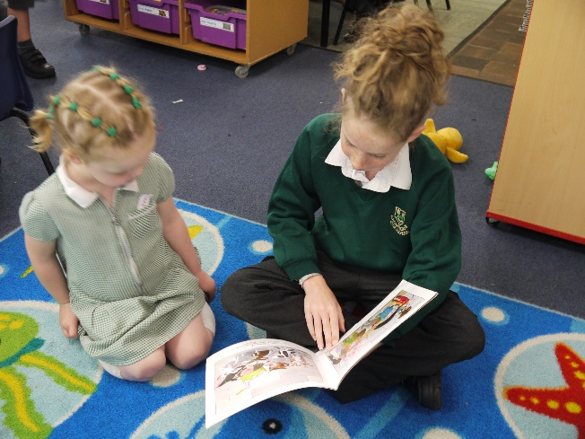
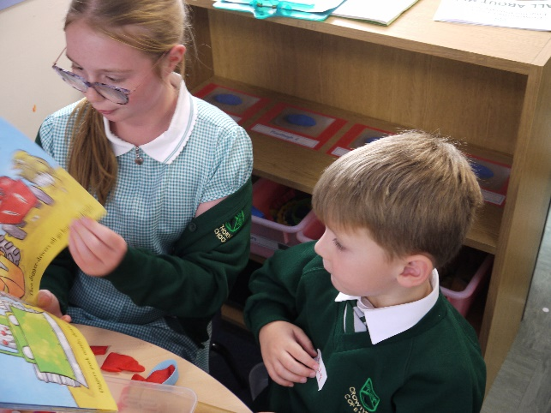
Inspiring and enabling our school community to live life to the full
Year 6 Buddies

